Slide 1
Analyzing MLB Player Performance Metrics and Game Outcomes
Benjamin Bartek
DSC 680
March 2, 2025

Slide 2
Business Problem
Major League Baseball (MLB) is a data-rich sport where analytics play a crucial role in team management, player trades, and game strategy. This study aims to identify key performance metrics that predict success in batting and pitching and optimize decision-making for teams.

Slide 3
Background & History
Baseball analytics have evolved significantly since the introduction of sabermetrics in the 1970s. Advanced metrics like OPS, WAR, and FIP have become crucial in evaluating players. With modern machine learning and data visualization, teams can now gain deeper insights into player performance trends.

Slide 4
Data Set
Dataset: 2023 MLB Player Stats from Kaggle.
Batting Stats: BA, OBP, SLG, HR, RBI, SO.
Pitching Stats: ERA, WHIP, SO, IP, HR9, BB9.
Data preprocessing included handling missing values, encoding categorical data, and feature engineering.

Slide 5
Methods
Descriptive statistics for player performance trends.
Correlation analysis to identify key performance drivers.
Predictive modeling using Linear Regression and Random Forest Regressors.
Feature importance analysis for OPS and ERA predictions.
Cross-validation techniques for model validation.

Slide 6
Analysis & Key Findings
OPS strongly correlates with SLG and OBP, with an R-squared value of 0.999.
Teams with high OPS scores tend to score more runs (correlation: 0.91).
Pitching metrics like WHIP and HR9 influence ERA rankings significantly.
Starting pitchers generally maintain lower ERA values than relievers.

Slide 7
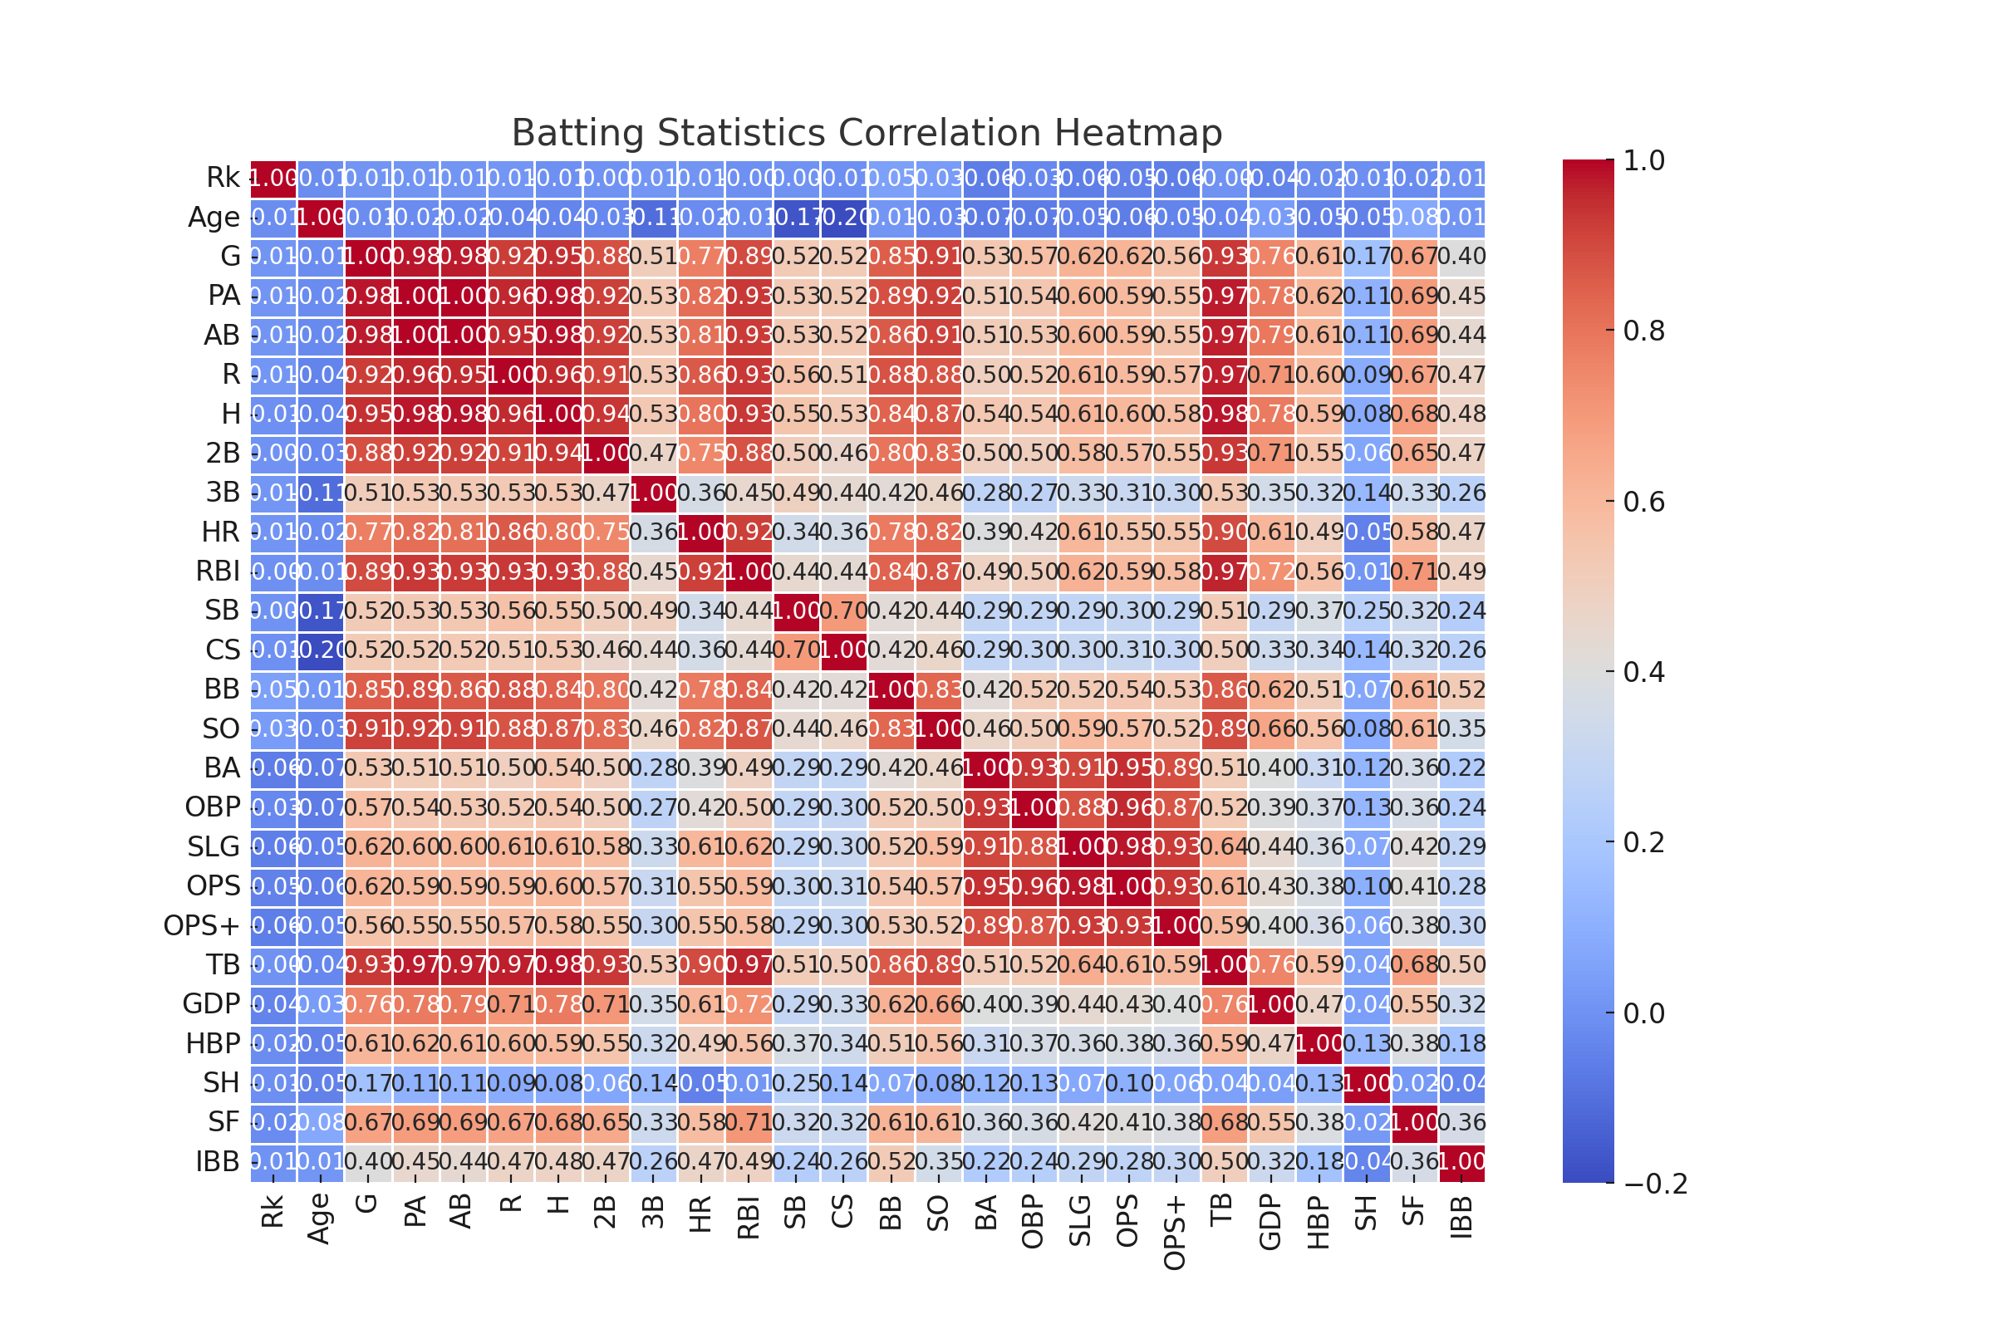
Figure 1: Batting Statistics Correlation Heatmap

Slide 8
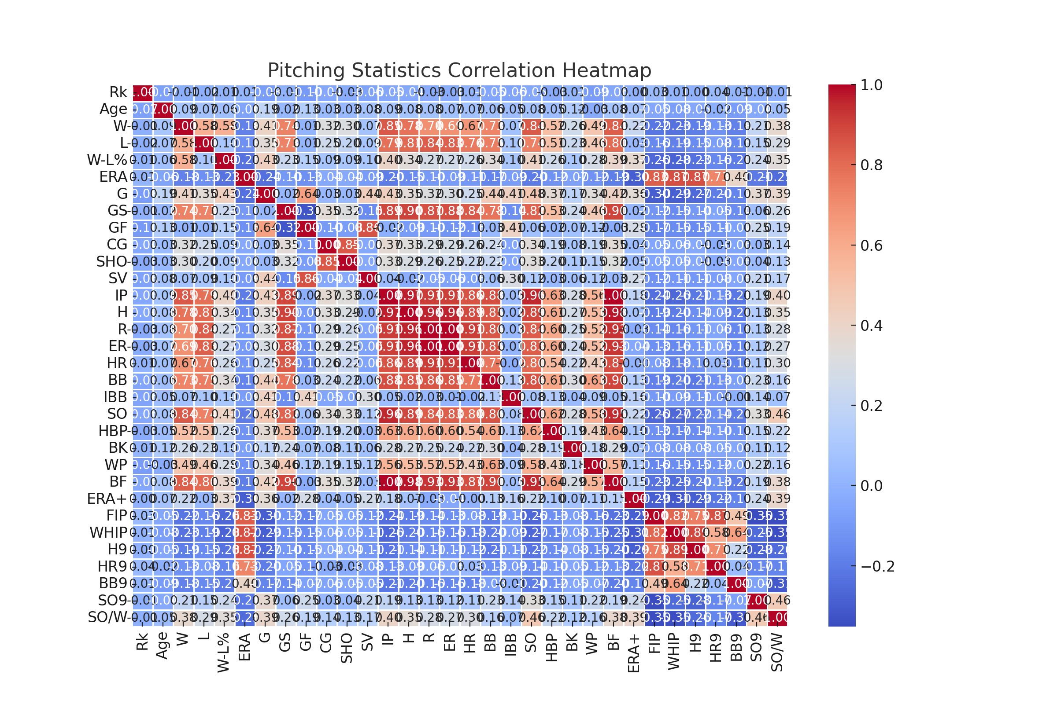
Figure 2: Pitching Statistics Correlation Heatmap

Slide 9
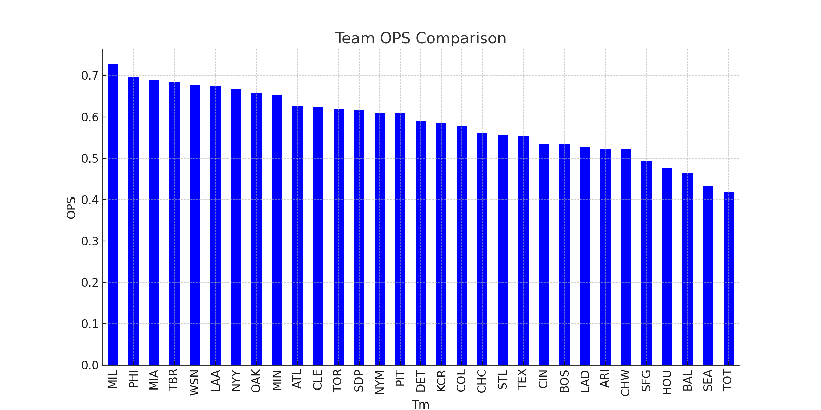
Figure 3: Team OPS Comparison

Slide 10
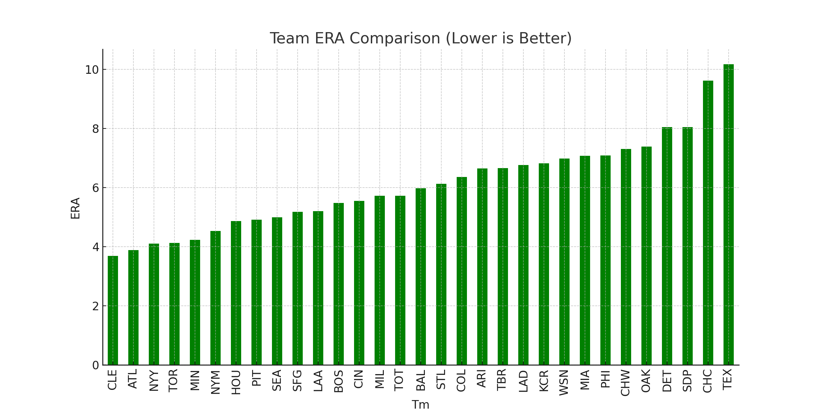
Figure 4: Team ERA Comparison

Slide 11
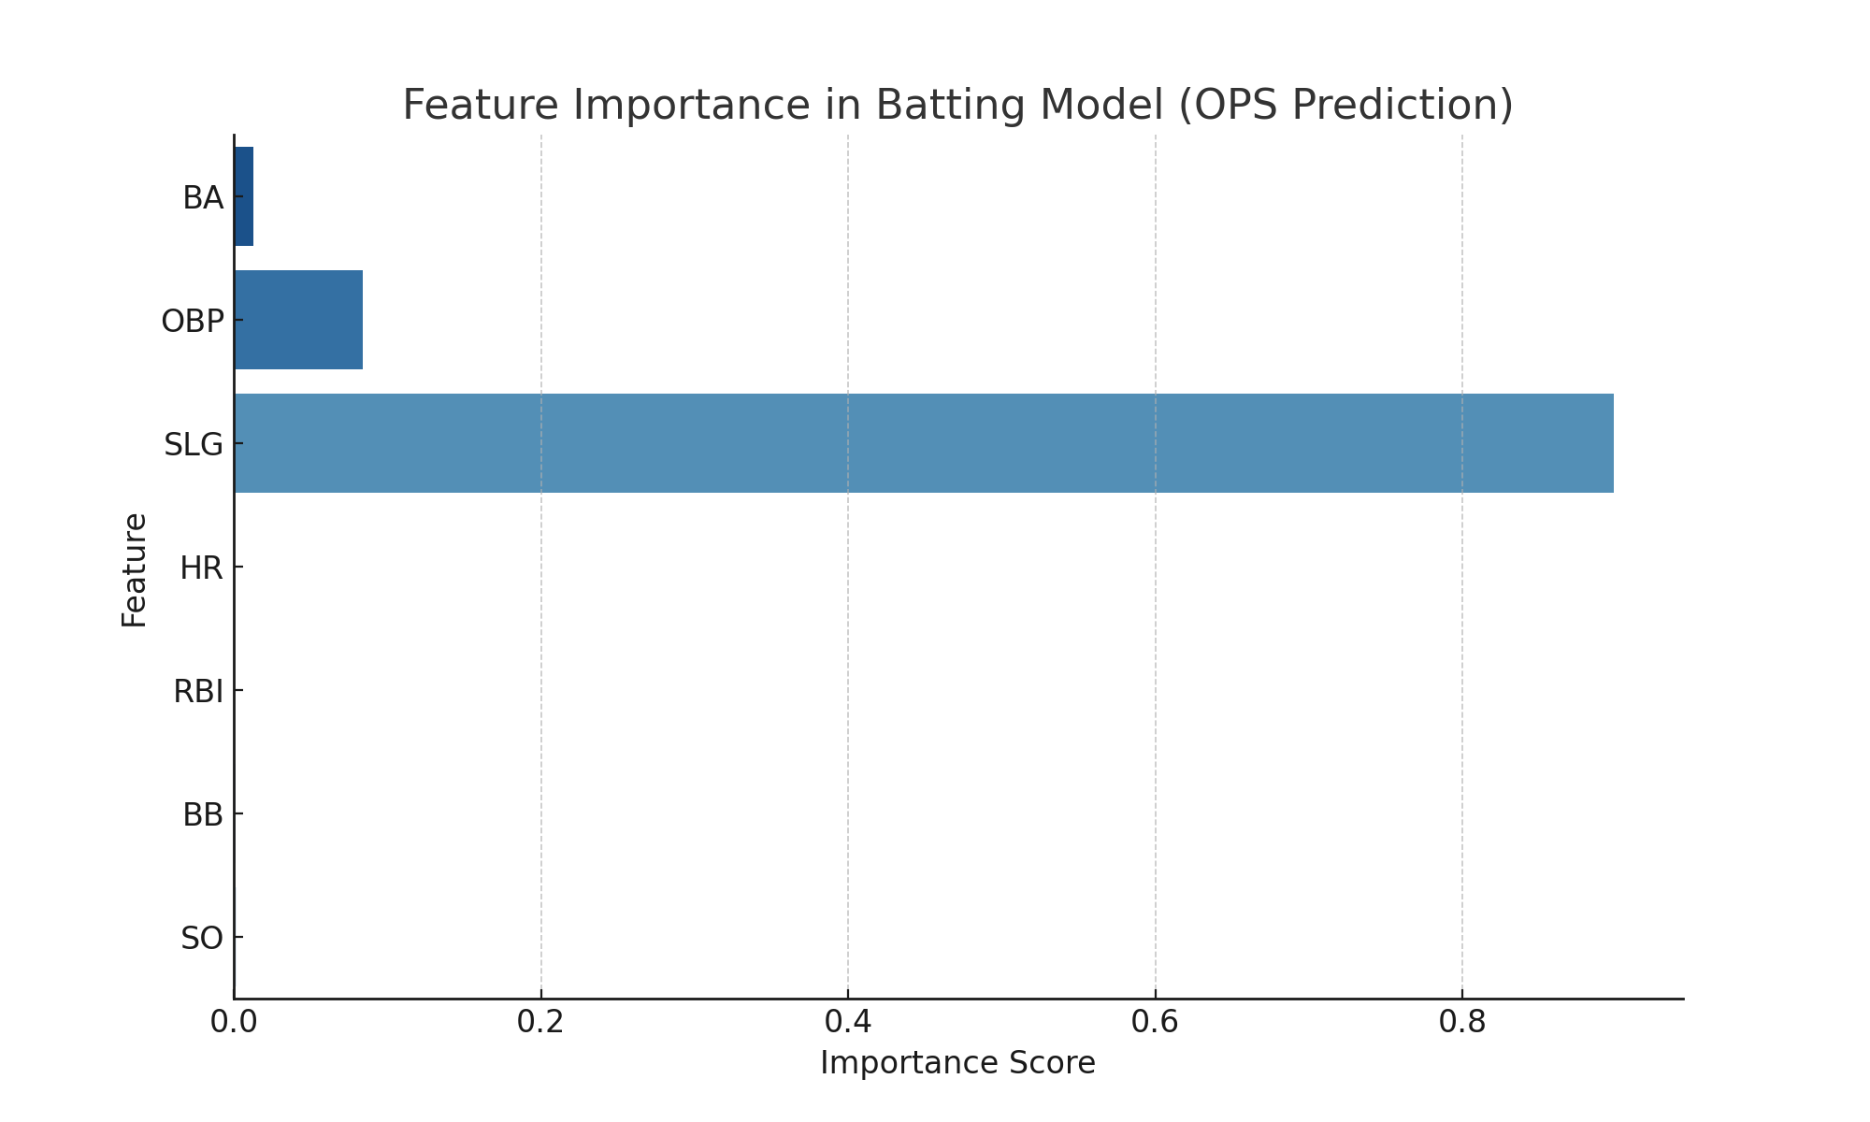
Figure 5: Feature Importance in Batting Model

Slide 12
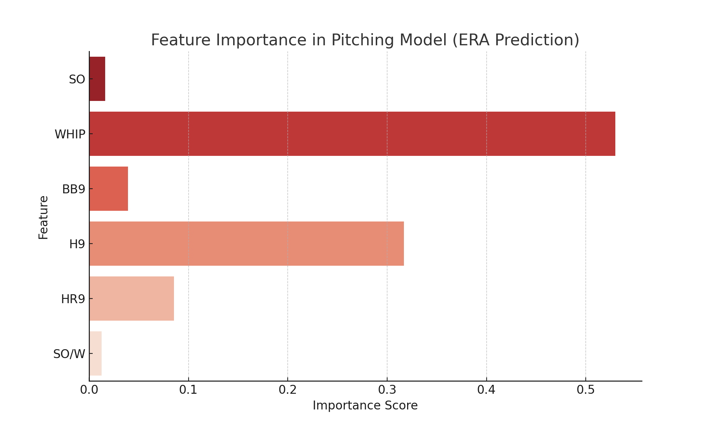
Figure 6: Feature Importance in Pitching Model

Slide 13
Recommendations
Teams should prioritize OPS over traditional stats like BA for player evaluations.
Pitching strategy should focus on reducing WHIP and walks per nine innings.
Real-time data from MLB Statcast should be integrated for in-game decision-making.
Future studies should incorporate multi-season trends and advanced sabermetrics.

Slide 14
Ethical Considerations
Ensure transparency in player evaluations.
Avoid over-reliance on models that may overlook intangible player qualities.
Address privacy concerns when incorporating biometric data.
Maintain fairness in data-driven player assessments.

Slide 15
References
Vinco, V. (2023). 2023 MLB Player Stats [Data set]. Kaggle. https://www.kaggle.com/datasets/vivovinco/2023-mlb-player-stats

